Slide 1
CSE7302 - INTERNSHIP Review- 5 Presentation Web-Based Vehicle and Rail Wheel Monitoring System with Object Detection
Student Details
Name | KARTHIK
Roll No | 20231CSE3047
Section | 8CSE07
Under the Supervision of,
Mr. Sakthi S
Assistant Professor
Presidency School of CSE
Presidency University
Name of the Program: Internship
Name of the HoD: Dr. Blessed Prince
Name of the Program Internship Coordinator: Ms. Vidya R
Name of the School Internship Coordinator: Dr. Md Ziaur Rahman

Slide 2
Content
About Company or Organization
Working domain or the technology
About your team and reporting Manager
Challenges Faced in Internship
Objectives of the work
Literature Review
Proposed System
Problem Statement
System Requirements
Advantages of Proposed System/Work
System Design
System Implementation
Internship Roadmap
Github Link

Slide 3
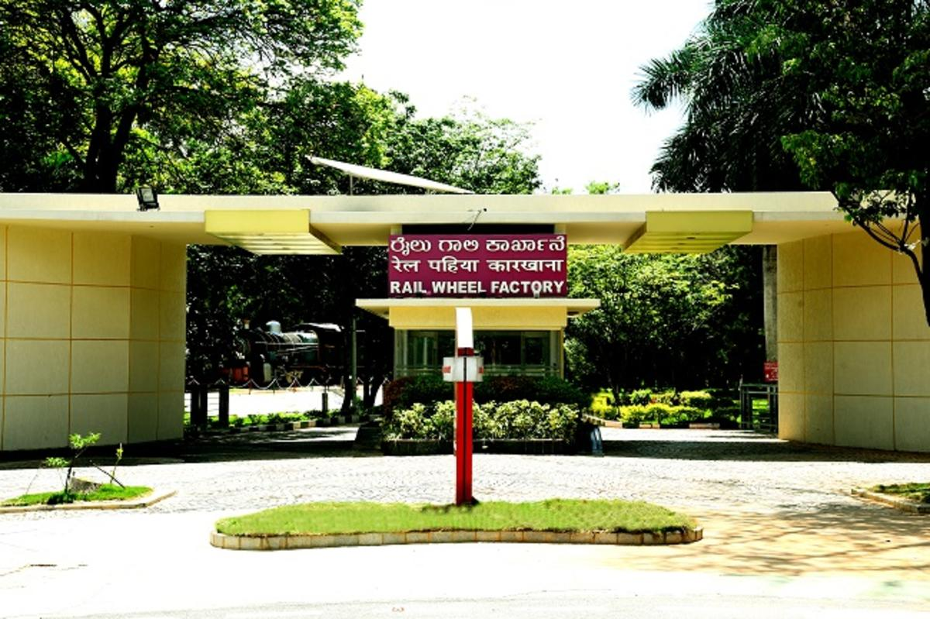
About Company or Organization
Organization Name
Rail Wheel Factory (RWF)
Type
Government of India Enterprise (Under Ministry of Railways)
Location
Yelahanka, Bengaluru, Karnataka
Overview
Rail Wheel Factory manufactures cast steel railway wheels and axles used in Indian Railways. The organization maintains strict quality standards and is moving towards automation and digital monitoring systems.

Slide 4
Working domain or the technology
Project Title
Web-Based Vehicle and Rail Wheel
Monitoring System with Object Detection
Internship Domain
Full Stack Development with AI Integration
Technologies Used
Programming Language: Python
Backend: Python Flask
AI Module: OpenCV + Object Detection
Frontend: Basic Web Dashboard
Database: SQL
Version Control: GitHub

Slide 5
About your team and reporting Manager
Individual Leader: Karthik
I worked under the guidance of my Team Lead: Mr. Buddha AppaRao at Rail Wheel Factory.
My team consisted of software engineers, supervisors, and interns.
I was involved in developing the AI Face Recognition Attendance System.
My responsibilities included frontend, backend, and AI model integration.
I received regular guidance, reviews, and technical support from my team lead.
Periodic discussions helped in improving my technical and professional skills.

Slide 6
Challenges Faced in Internship
1. Detection-Related Challenges
Accurate detection of rail wheels inside loaded trucks
Differentiating wheels from similar circular objects
Handling multiple wheels in a single video frame
Maintaining detection accuracy under varying lighting conditions
2. Backend Integration Challenges
Integrating object detection output with Flask REST APIs
Processing real-time detection results efficiently
Managing structured API responses
3. Database Management Challenges
Designing proper schema for vehicle and wheel records
Preventing duplicate inward/outward entries
Ensuring accurate data storage and retrieval

Slide 7
Objectives of the work
Primary Objectives
Automate vehicle entry and exit monitoring at factory gates
Detect and count rail wheels loaded inside trucks using object detection
Store inward and outward movement records in a centralized database
Reduce manual counting errors and improve operational efficiency
Develop a scalable web-based monitoring dashboard
Technical Objectives
Integrate detection module with Flask backend
Implement SQL database for structured record storage
Enable API-based data communication between modules
Validate system workflow through testing

Slide 8
Literature Review
S.No | Title of the Paper | Year | Algorithm / Technique Used | Advantages | Disadvantages
1 | Real-Time Railway Track Defect Detection and Complaint Redressal Using YOLOv8 | 2025 | YOLOv8 (CSP-Darknet + PANet), IoU filtering, Flask-based redressal system | - High accuracy (mAP@0.5 ≈ 93.4%) - Real-time detection (32 FPS) - Integrated complaint/redressal system - Scalable and deployable | - Requires large annotated dataset - Computational cost for edge devices - Depends on environmental conditions (lighting, noise)
2 | Railway System Based on Object Detection | 2024 | CNN-based object detection, clustering, video analytics | - Useful for obstacle detection (humans, animals, vehicles) - Supports accident prevention - Works with CCTV systems | - Less advanced compared to YOLO models - Lower accuracy & speed - High installation cost for sensors - Limited real-time optimization
3 | Railway Objects Detection Using Improved YOLO Algorithm | 2025 | Improved YOLOv8 with CBAM attention, data augmentation, custom loss (IoU + focal loss) | - Improved mAP (+8.5%) - Reduced false positives - Faster inference (25% improvement) - Suitable for edge deployment | - Model complexity increased - Requires GPU for training - Still sensitive to occlusion & lighting variations
4 | Real-Time Vision-Based Wheel-Rail Interface Monitoring for Tramway | 2025 | YOLOv8-segmentation + vision-based measurement + stabilization modules | - Very high precision (≈0.46 mm error) - Real-time monitoring - Non-contact system (camera-based) - Works under varied conditions | - Hardware setup required (camera, calibration) - Sensitive to lighting/environment noise - Complex calibration process
5 | AI-Powered Real-Time Wheel Defect Detection | 2025 | Multiple YOLO models (v5–v12) + RTD Transformer | - High accuracy (≈92% mAP) - Real-time detection (30 FPS) - Works on edge devices - Handles multiple defect types | - Dataset imbalance issues - High training complexity - Transformer adds computational overhead

Slide 9
Proposed System / Work
Proposed System
The proposed system automates vehicle and rail wheel
monitoring using object detection and full-stack Integration.
System Flow
Camera captures vehicle at factory gate
Object detection identifies vehicle and rail wheels
Wheel count is generated automatically
Backend processes detection results
Data stored in SQL database
Dashboard displays inward and outward records

Slide 10
Problem Statement
Problem Statement
Vehicle entry and exit at factory gates are recorded manually.
Rail wheel counting inside trucks depends on human inspection.
Manual counting increases the possibility of errors.
CCTV cameras are used only for surveillance, not automation.
No integrated system connects camera input, backend processing, and database storage.
This results in lack of real-time tracking, reduced efficiency, and dependency on manual processes.

Slide 11
System Requirements
Hardware Requirements
CCTV / Industrial Camera at entry and exit gates
Processing System (PC with sufficient RAM and GPU support if required)
Stable Network Connectivity
Software Requirements
Python
Flask (Backend API)
SQL Server (Database)
OpenCV (Object Detection)
ReactJS (Web Dashboard)
Postman (API Testing)

Slide 12
Advantages of Proposed System/Work
Future Enhancements
Improve detection accuracy using trained datasets
Implement full number plate recognition (OCR integration)
Complete real-time dashboard integration
Add automatic entry/exit direction detection
Optimize system performance for live video processing
Prepare system for deployment in real factory environment

Slide 13
System Design
Start System
Initialize Camera System
Capture Vehicle Image
or Video Frame
Send Detection Data
to Flask Backend API
Preprocess Image
Using OpenCV
Store Vehicle and
Wheel Data in
SQL Database
Apply Object Detection
Model
YES
NO
Display Monitoring
Data in Web
Dashboard
Detect Rail Wheels
Inside the Truck
Is Vehicle
Detected?
Capture Next Frame
Count Number
of Rail Wheels
End System

Slide 14
System Implementation (50%)
Start System
The monitoring system is started and the required modules are initialized.
Initialize Camera and Video Capture
The CCTV or connected camera is initialized to capture vehicle images or video frames at the factory gate.
Capture Vehicle Image / Video Frame
The system continuously captures frames from the camera to monitor incoming vehicles.
Preprocess Image using OpenCV
The captured frame is processed using OpenCV techniques such as resizing and filtering to improve detection performance.
Apply Object Detection Model
The object detection algorithm is applied to identify vehicles and rail wheels present in the image.

Slide 15
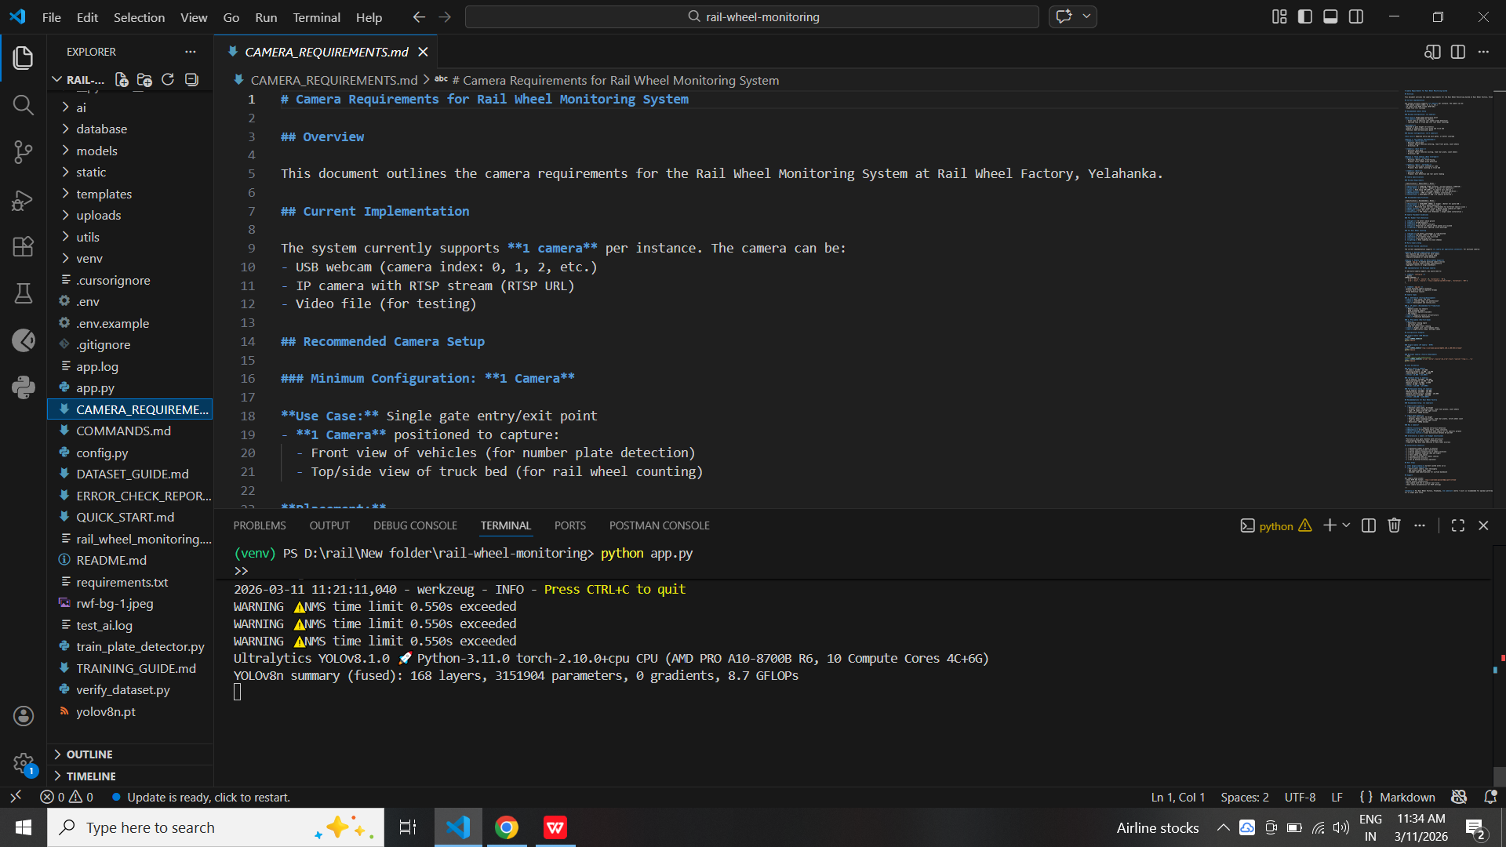
System Execution

Slide 16
System Implementation
Vehicle Detected? (Decision)
The system checks whether a vehicle is detected in the captured frame.
Detect Rail Wheels
If a vehicle is detected, the system analyzes the truck area and detects rail wheels inside the vehicle.
Count Number of Rail Wheels
The system counts the number of detected rail wheels automatically.
Send Detection Data to Flask Backend API
The detection results including vehicle details and wheel count are sent to the backend server using Flask REST APIs.
Store Vehicle and Wheel Data in SQL Database
The backend stores the vehicle entry information and rail wheel count in the SQL database for monitoring and record management.

Slide 17
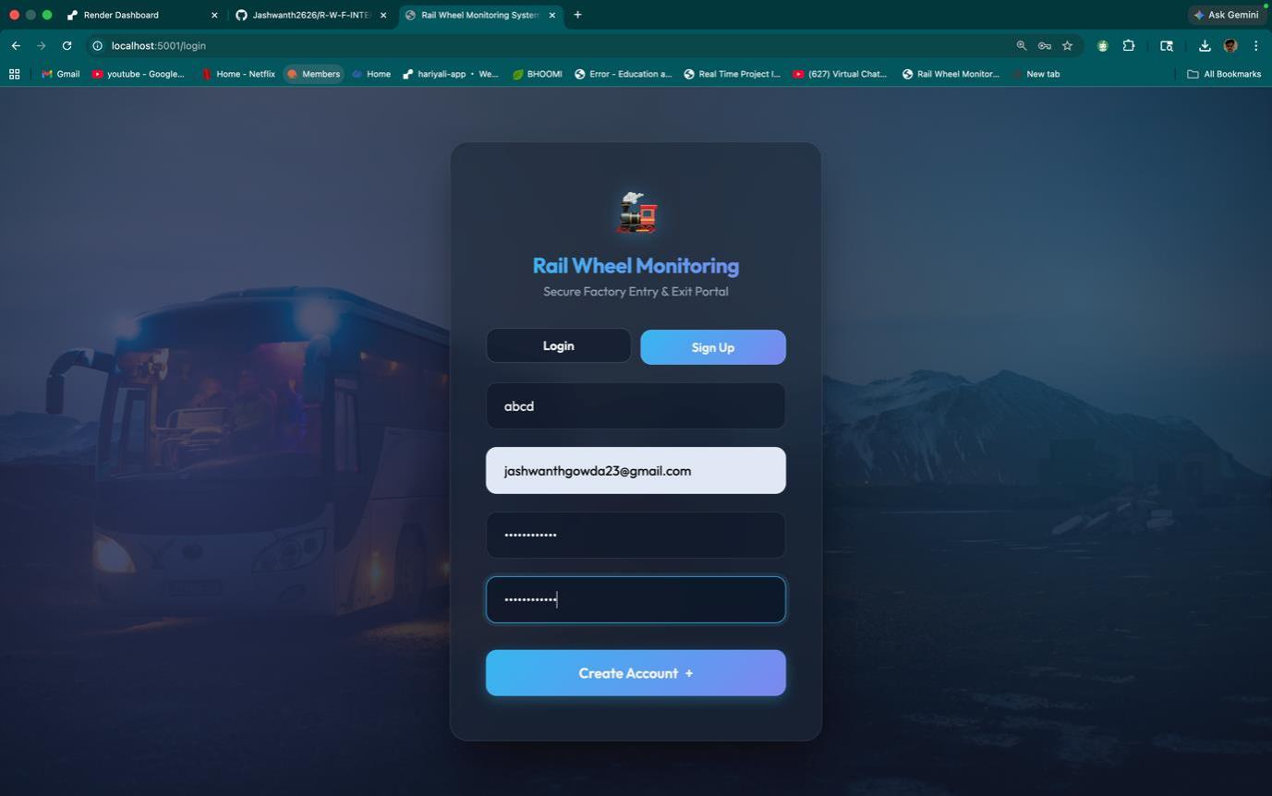
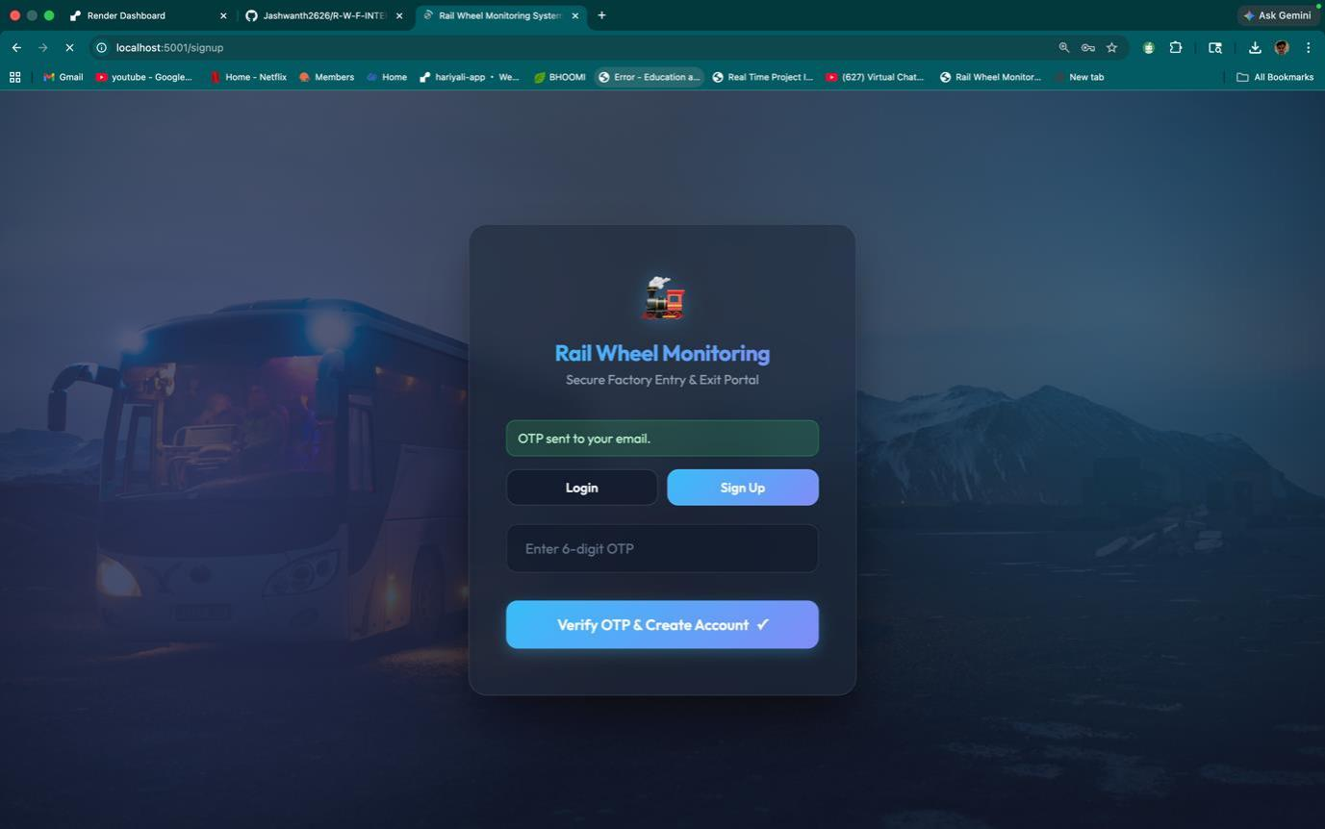
System Execution

Slide 18
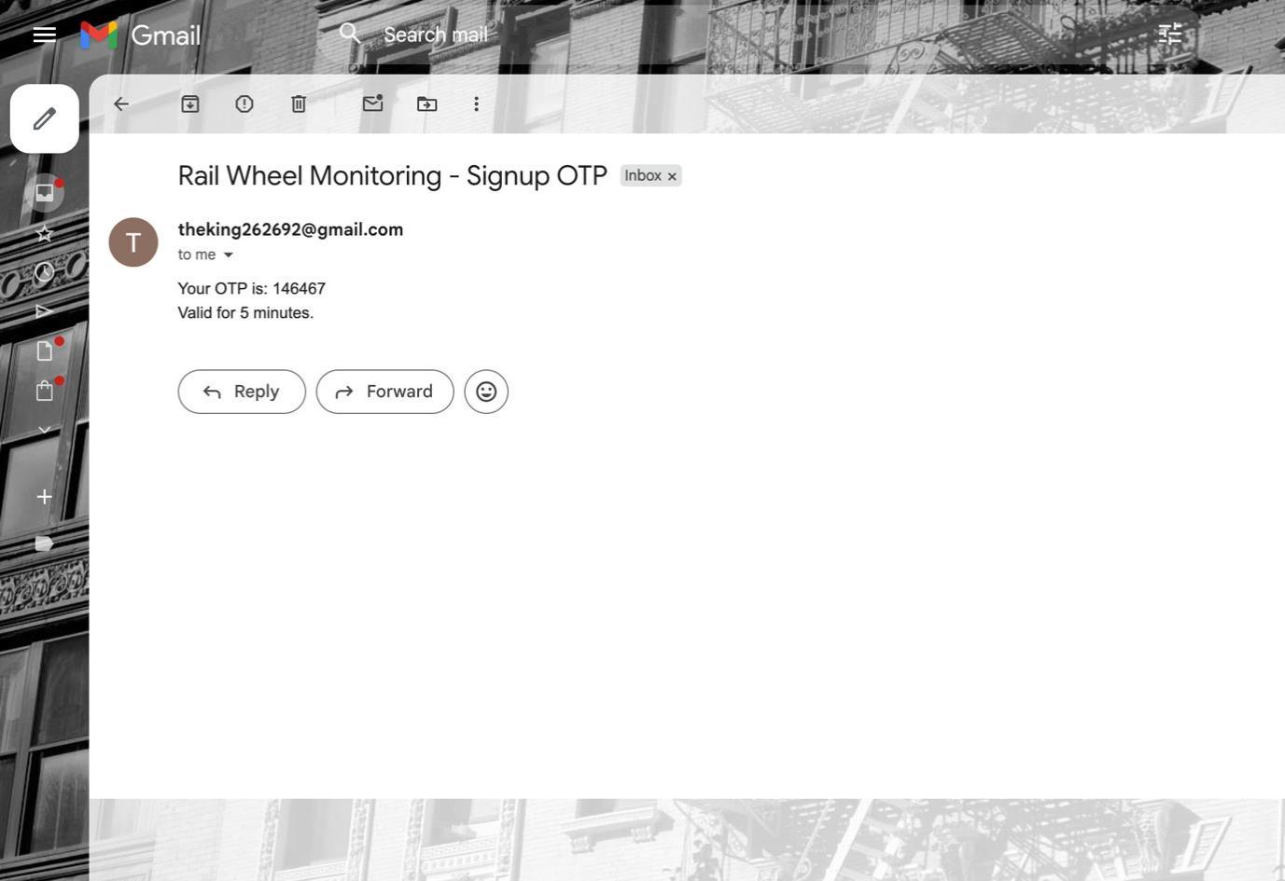
System Execution

Slide 19
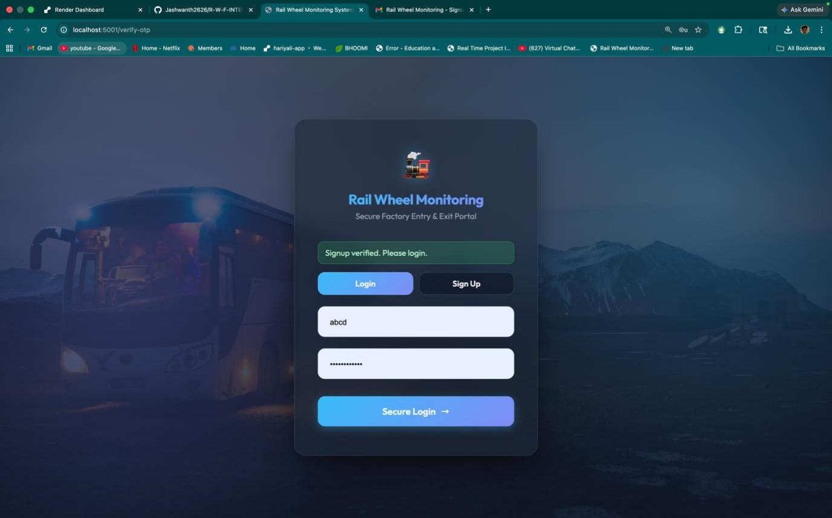
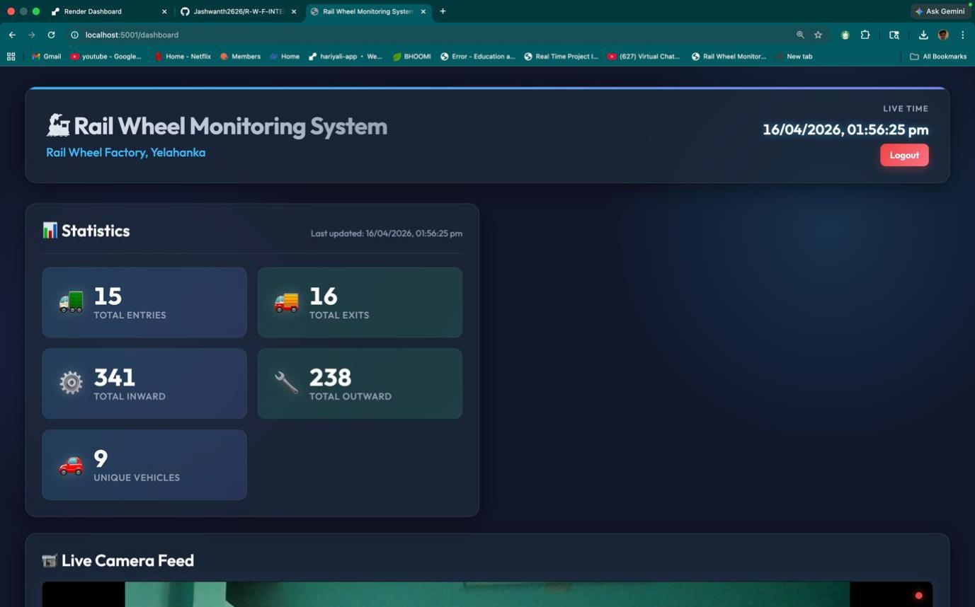
System Execution

Slide 20
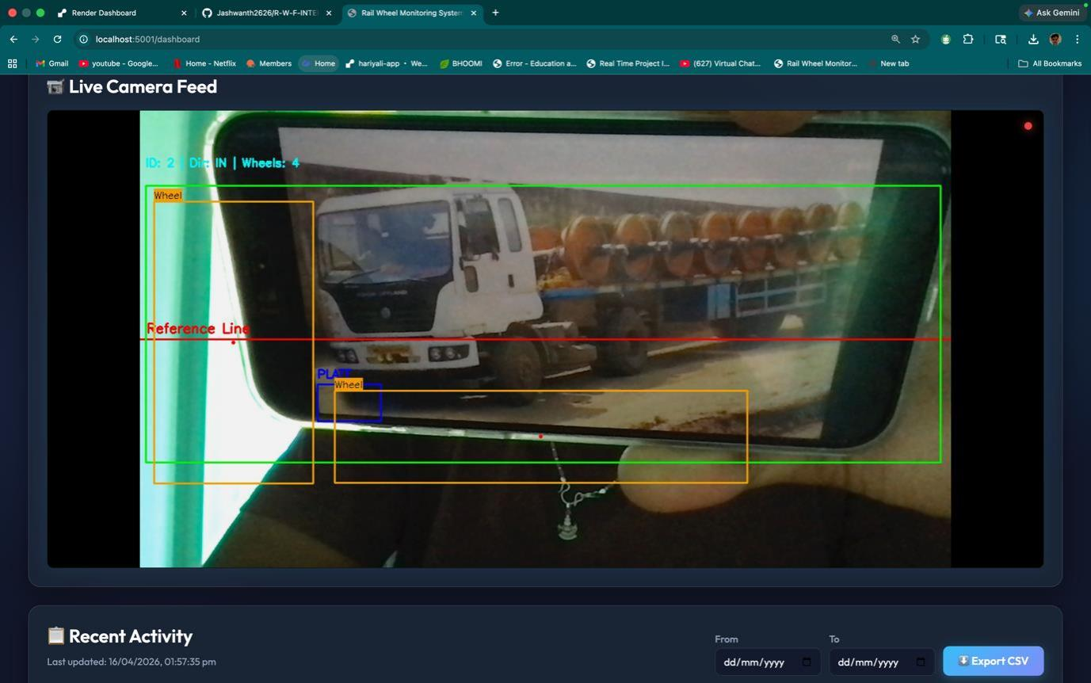
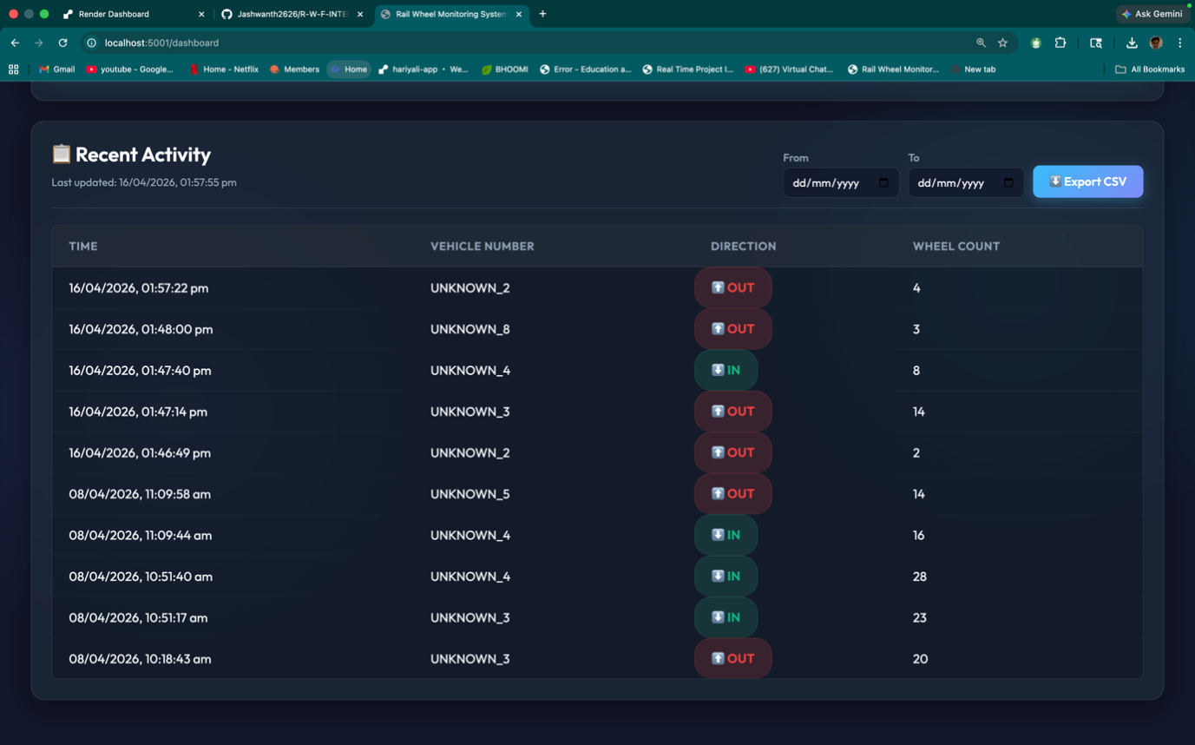
System Execution

Slide 21
System Testing
1. Functional Testing
To check if system works correctly
Example:
Vehicle detection working or not
Rail wheel counting is accurate
2. API Testing
To verify communication between:
Frontend ↔ Backend (Flask API)
Ensures data is sent and received properly
3. Database Testing
To check: Data stored correctly in SQL database
Data stored correctly in SQL database

Slide 22
System Testing
4. Performance Testing
To check system under different conditions:
Multiple vehicles
Different lighting
Real-time video processing
5. Integration Testing
To ensure all modules work together:
Camera + OpenCV + Flask + Database + Dashboard

Slide 23
Main Algorithm
Main Algorithm: Object Detection Algorithm
Used through:OpenCV AI-based detection model
How it Works:
Capture image/frame from camera
Preprocess image (resize, filtering)
Apply object detection
Detect:
Vehicle
Rail wheels
5. Count number of wheels
6. Send result to backend

Slide 24
Conclusion
The project successfully developed a web-based vehicle and rail wheel monitoring system using AI and full-stack technologies.
Manual errors in wheel counting and vehicle tracking were reduced significantly.
Integration of OpenCV, Flask, and SQL database enabled automation and real-time monitoring.
The system improved operational efficiency at factory gate management.
The project enhanced practical knowledge in AI, backend development, and system integration.
The solution can be further improved and deployed in real industrial environments.

Slide 25
References
OpenCV Documentation – https://opencv.org/
Flask Documentation – https://flask.palletsprojects.com/
Python Official Documentation – https://docs.python.org/3/
SQL Documentation – https://www.mysql.com/
/ https://www.microsoft.com/en-us/sql-server
Research papers on Object Detection (Google Scholar / IEEE)
GitHub Repository: https://github.com/Karthik8844/INTERNSHIP
Online tutorials and technical blogs related to Computer Vision and Full Stack Development

Slide 26
Internship Road Map
Review 1
Review 2
Review 3
Review 4
Final Review
Understanding project requirements
Studying basics of Computer Vision and Object Detection
Learning Python and OpenCV basics
Understanding vehicle monitoring problem
Literature survey and problem identification
Studying object detection techniques
Understanding OpenCV image processing
Designing system architecture
Planning backend and database structure
Preparing initial project design
Developing backend using Flask
Integrating object detection module
Creating SQL database tables
Testing vehicle detection and wheel counting
Initial system workflow implementation
Integrating frontend dashboard with backend
Connecting database with web dashboard
Implementing real-time monitoring system
Testing system performance and accuracy
Improving detection performance
Final system testing and validation
Complete project demonstration
Documentation and report preparation
GitHub project submission
Internship completion

Slide 27
Github Link
https://github.com/Karthik8844/INTERNSHIP

Slide 28
Thank you !!

